Slide 1
Simulating Literature through Randomization, Adjacency Prediction, and Spacial Memory Recognition
Benjamin Breer
Manoj Niverthi

Slide 2
Introduction – The Game of Literature
Literature, otherwise known as Canadian Fish, is a team-based card game involving 6 players
It is most commonly played with a 48-card deck without 8s
Having been played for 50 years, the game originated in India
However, many variants of the game exist around the world

Slide 3
Game Structure & Set-Up
The game consists of 2 teams with 3 players each
Removing the 8s yields a 48-card deck which is dealt out to 6 players (8 cards each)
The objective of the game is to claim as many half-suits as possible
Lower half-suit (LHS): 2-3-4-5-6-7
Upper half-suit (UHS): 9-10-J-Q-K-A

Slide 4
Game Structure & Set-Up
To build half-suits, players ask members of the opposing team for cards
Players must ask for cards which they do not currently have, but they have a card in a similar half-suit
Players cannot ask for cards outside the half-suits they currently have
If a player does not have the requested card, then they become the next player to go

Slide 5
Winning & Scoring
The game ends when all 8 half-suits are claimed
Declaration of LHS/UHS:
One player gets all 6 cards in the half-suit
Player believes a half-suit is split between the members on his team
Declare by showing cards to the rest of the players & identifying which teammates have remaining cards
The team with the majority of the half-suits wins the game
Often times, ties occur as both teams end up with 4 half-suits
Including Jokers & 8s creates a 9th possible HS which breaks ties

Slide 6
General Strategies
Claims should be made as quickly as possible if the location of cards are known completely
Avoid asking players who are known to have lots of cards in a half-suit one is attempting to claim
A “rapid-fire” questioning session between players often divulges critical information about HS completion
Players can signal their teammates by asking for particular cards in a half-suit range which they do not have

Slide 7
Optimization algorithm which minimizes moves to obtain a half-suit
The Problem

Slide 8
Creating a Customized Literature Deck
Creates deck of 48 cards, removing 8s from traditional 52-card deck
Randomly selects player to begin game as well as base card to randomly select the first card to ask from
For instance, if Player 5 was chosen to ask first based on the 6 of Hearts, then they would ask for something in that half-suit range which they do not already have (i.e. 2-7 of Hearts, excluding 6)

Slide 9
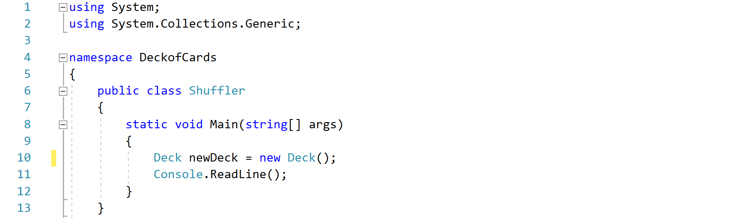
Creating & Initializing the Deck

Slide 10
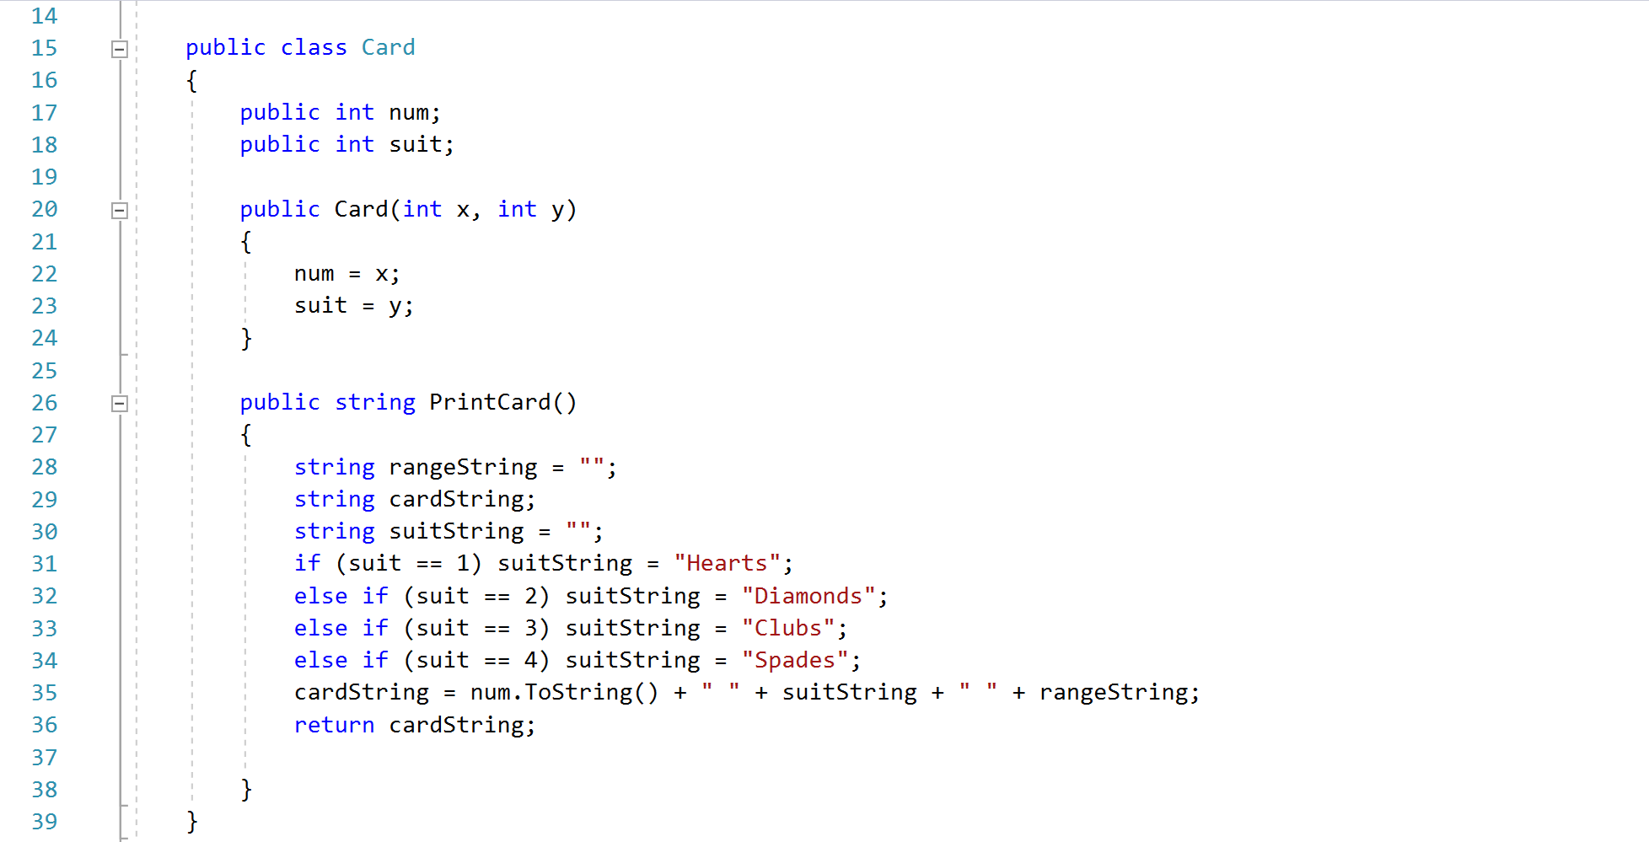
Card Class

Slide 11
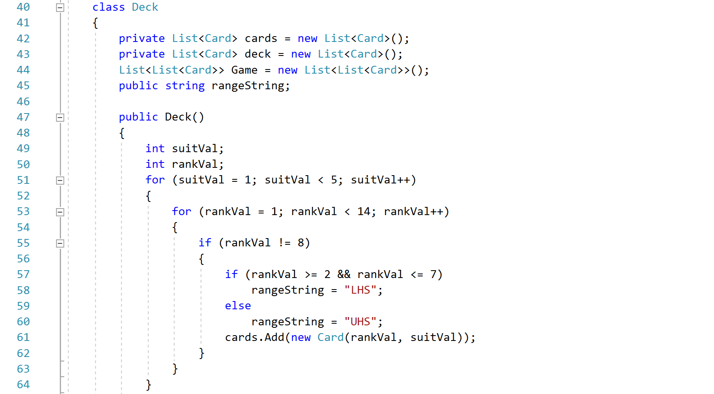
Deck Class — Creating Players’ Hands

Slide 12
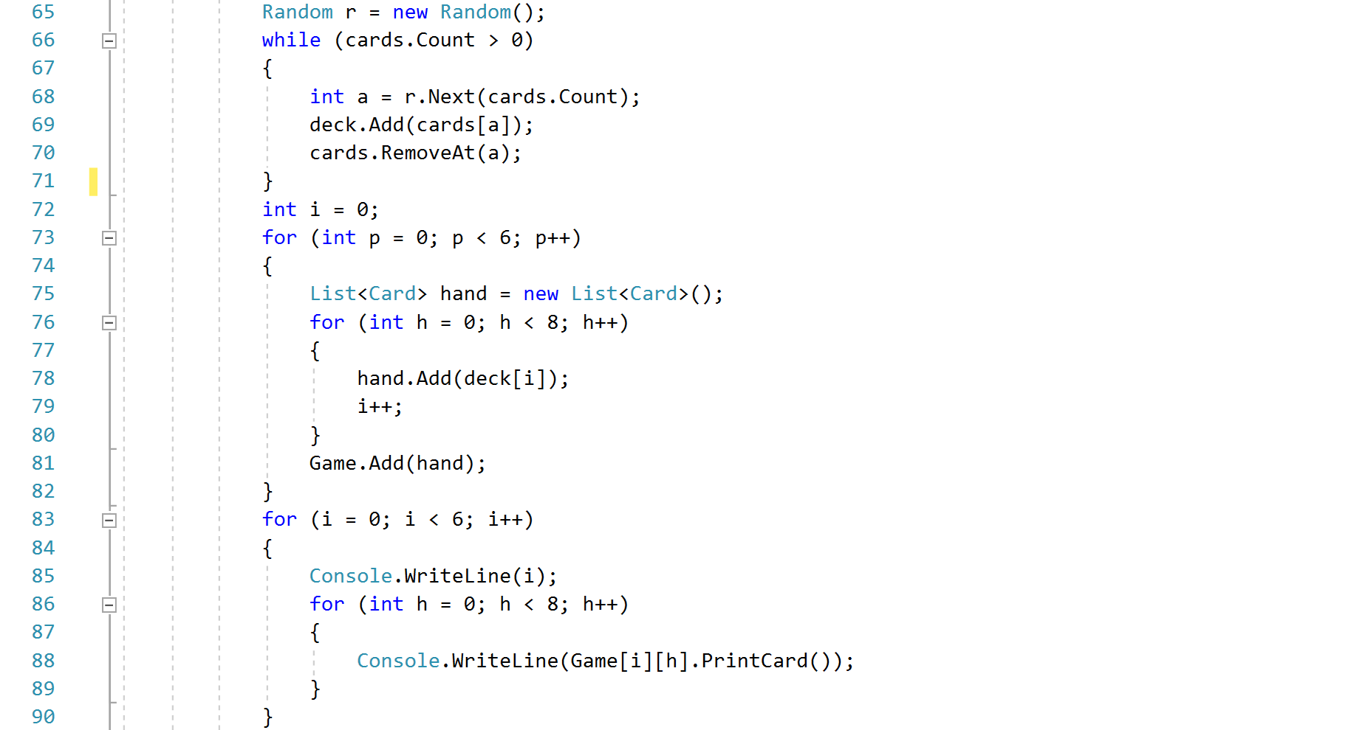
Deck Class — Cont’d

Slide 13
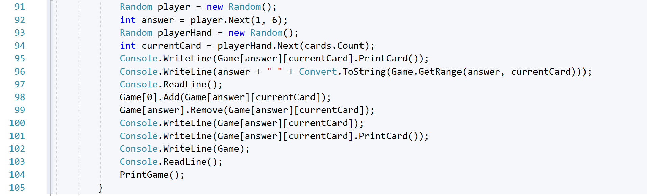
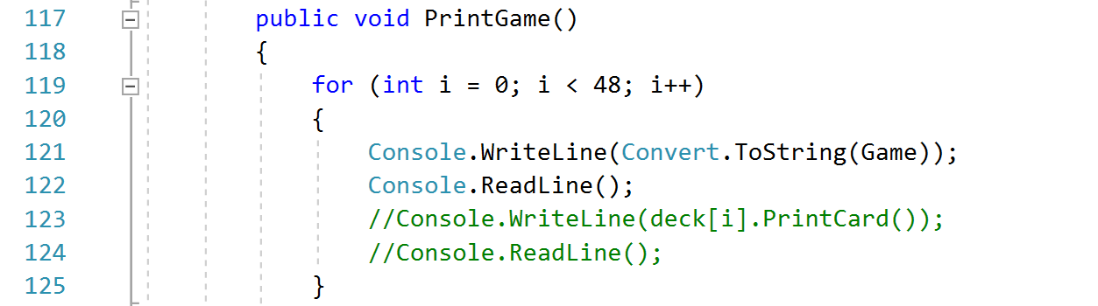
Selection of Hands & Cards

Slide 14
Producing an Algorithm — Fundamentals
Solely used by Player 0 (P0)
Aims to minimize the moves necessary for team 1 (T1) to obtain a half-suit
Success of algorithm is measured by the number of “moves”, or questions, that must be asked before P0 can declare T1 has obtained a half-suit
Includes randomization, adjacency prediction, and memory spaces

Slide 15
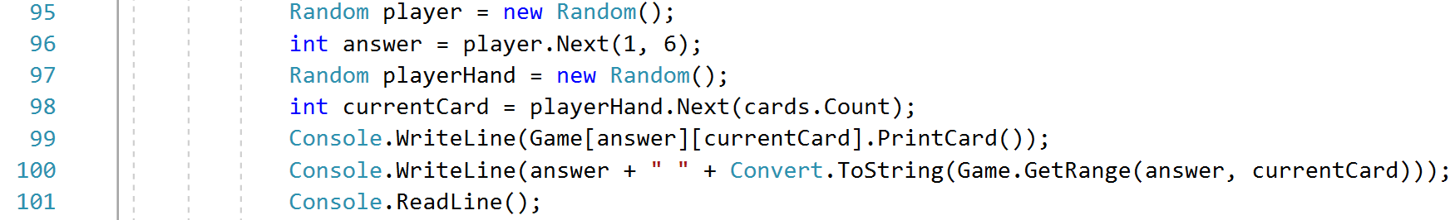
Randomization
Maintain uniformity for P1 – P5 card inquiries
Select starting card for game to begin
Aids in logical deduction for P0 to determine locations of remaining cards
Random number generators used

Slide 16
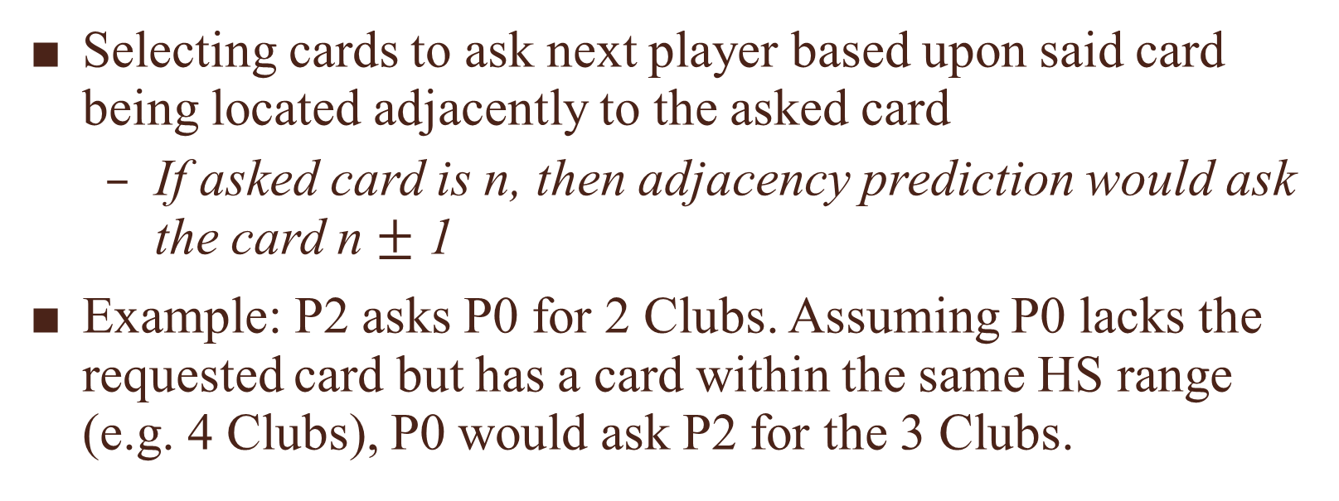
Adjacency Prediction
Selecting cards to ask next player based upon said card being located adjacently to the asked card
If asked card is n, then adjacency prediction would ask the card n $±$ 1
Example: P2 asks P0 for 2 Clubs. Assuming P0 lacks the requested card but has a card within the same HS range (e.g. 4 Clubs), P0 would ask P2 for the 3 Clubs.

Slide 17
Memory Spaces
P0 utilizes the memory space of ongoing game to logically deduce which players have which cards
Locates cards based on previous questions, players stripping cards from other players, and players receiving “null” as a response

Slide 18
Player 0
Memory space for moves
Using adjacency prediction to ask for cards
Logical deduction for confirming containment of half-suits

Slide 19
Randomized Players (1 – 5)
Randomly selects player to ask
Randomly selects “base” card to ask from
Randomly selects card within base card range to ask from

Slide 20
Simulation
A walk-through

Slide 21
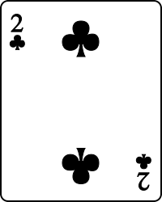
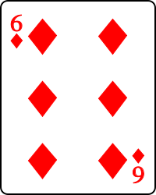
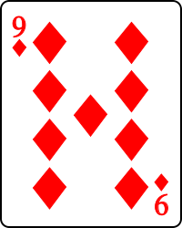
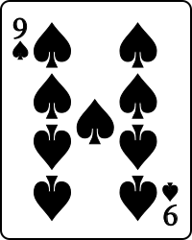
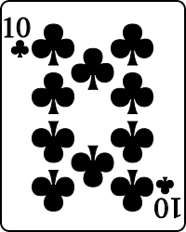
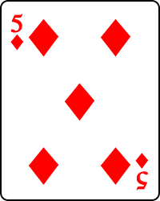
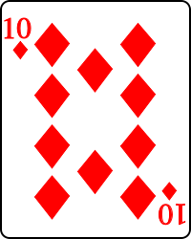
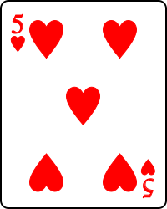
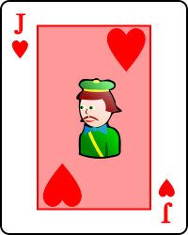
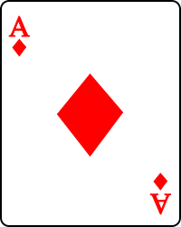
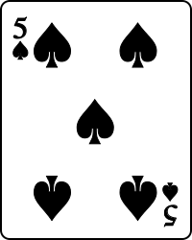
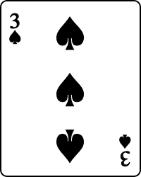
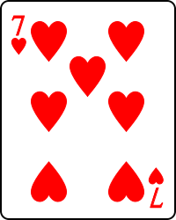
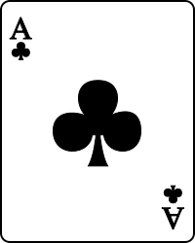
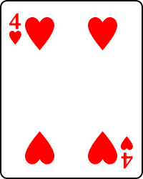
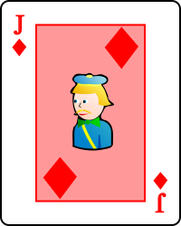
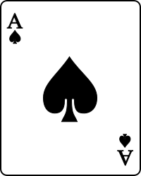
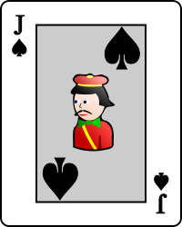
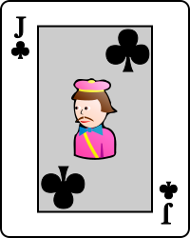
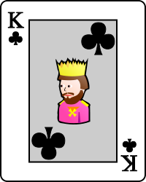
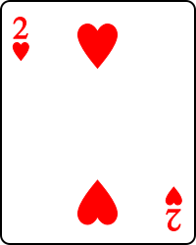
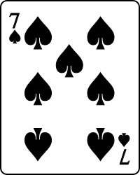
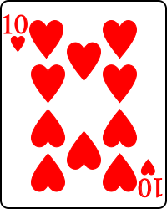
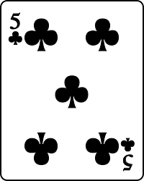
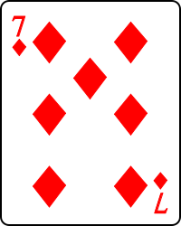
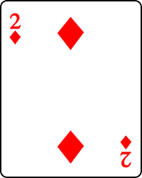
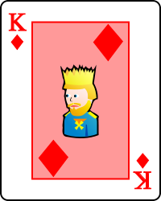
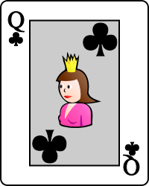
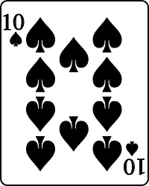
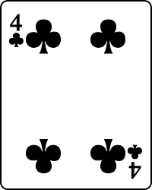
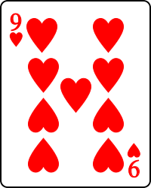
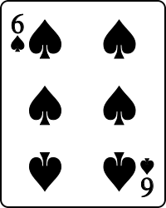
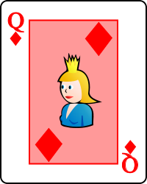
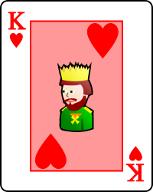
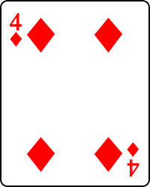
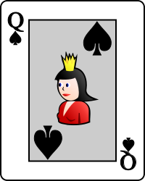
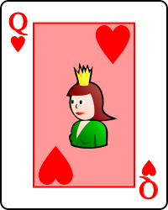
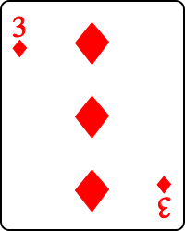
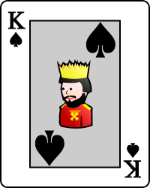
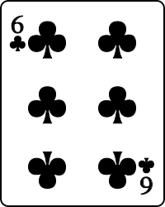
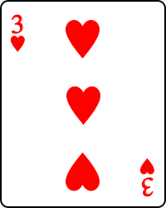
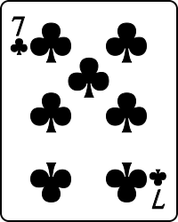






Simulation 9
Player 0
Player 1
Player 2
Player 3
Player 4
Player 5

Slide 22
Simulation 9 — Memory Spaces

Slide 24
Simulation Results
Randomization, Dealing Cards, and Intelligent Decision-Making

Slide 25
Results — Simulations & Control

Slide 26
Data Analysis — Minimizing Moves

Slide 27
Descriptive Statistics — Comparison

Slide 28

Inferential Statistics
To provide thorough analysis, a one-proportion, one-sided z-test was performed
Null Hypothesis (H0): p = 0.5
Alternative Hypothesis (Ha): $\hat{p}$ > p
p = proportion of simulations where
${\overline{N}}_{sim}$< $\overline{N}$

Slide 29


One-proportion, one-sided z-test
$\hat{p}$ = 6/10 = 0.6
SE(p) =$\sqrt{\frac{p∗q}{n}}=\sqrt{\frac{(0.5)(0.5)}{10}}$ = 0.025
P $\sim$ N(0.5, 0.025)
P($\hat{p}$ > 0.6) = P$\left(\text{z}\text{ < }\left(\frac{\hat{p }− p}{SE(p)}\right)\right)$
= P$\left(\text{z}\text{ < }\left(\frac{0.6 −0.5}{0.025}\right)\right)$= P(z < 4)
= normcdf(-$∞, 4, 31.5 , 0.025)$
= 1.489 x ${10}^{−84}$ $≈$ 0.000 => p-value
Set α = 0.01 (1%)
p-value < α
0.000 < 0.01
Conclusion:
Because the p-value (0.000) is less than alpha (α = 0.01), we reject the null hypothesis (H₀) and suggest the alternative that the proportion of simulations $\hat{p}$ where ${\overline{N}}_{sim}$< $\overline{N}$ is greater than p = 0.5.

Slide 30
Avenues of Future Research
Including more than one strategized-player
Performing more than 10 strategized simulations to conform to the Law of Large Numbers, a critical aspect to meet when performing statistical inferences
Perform simulations with the 8s and Jokers included as another HS

Slide 31
Thank you for your time!
2017 GHP Mathematics

